Slide 1
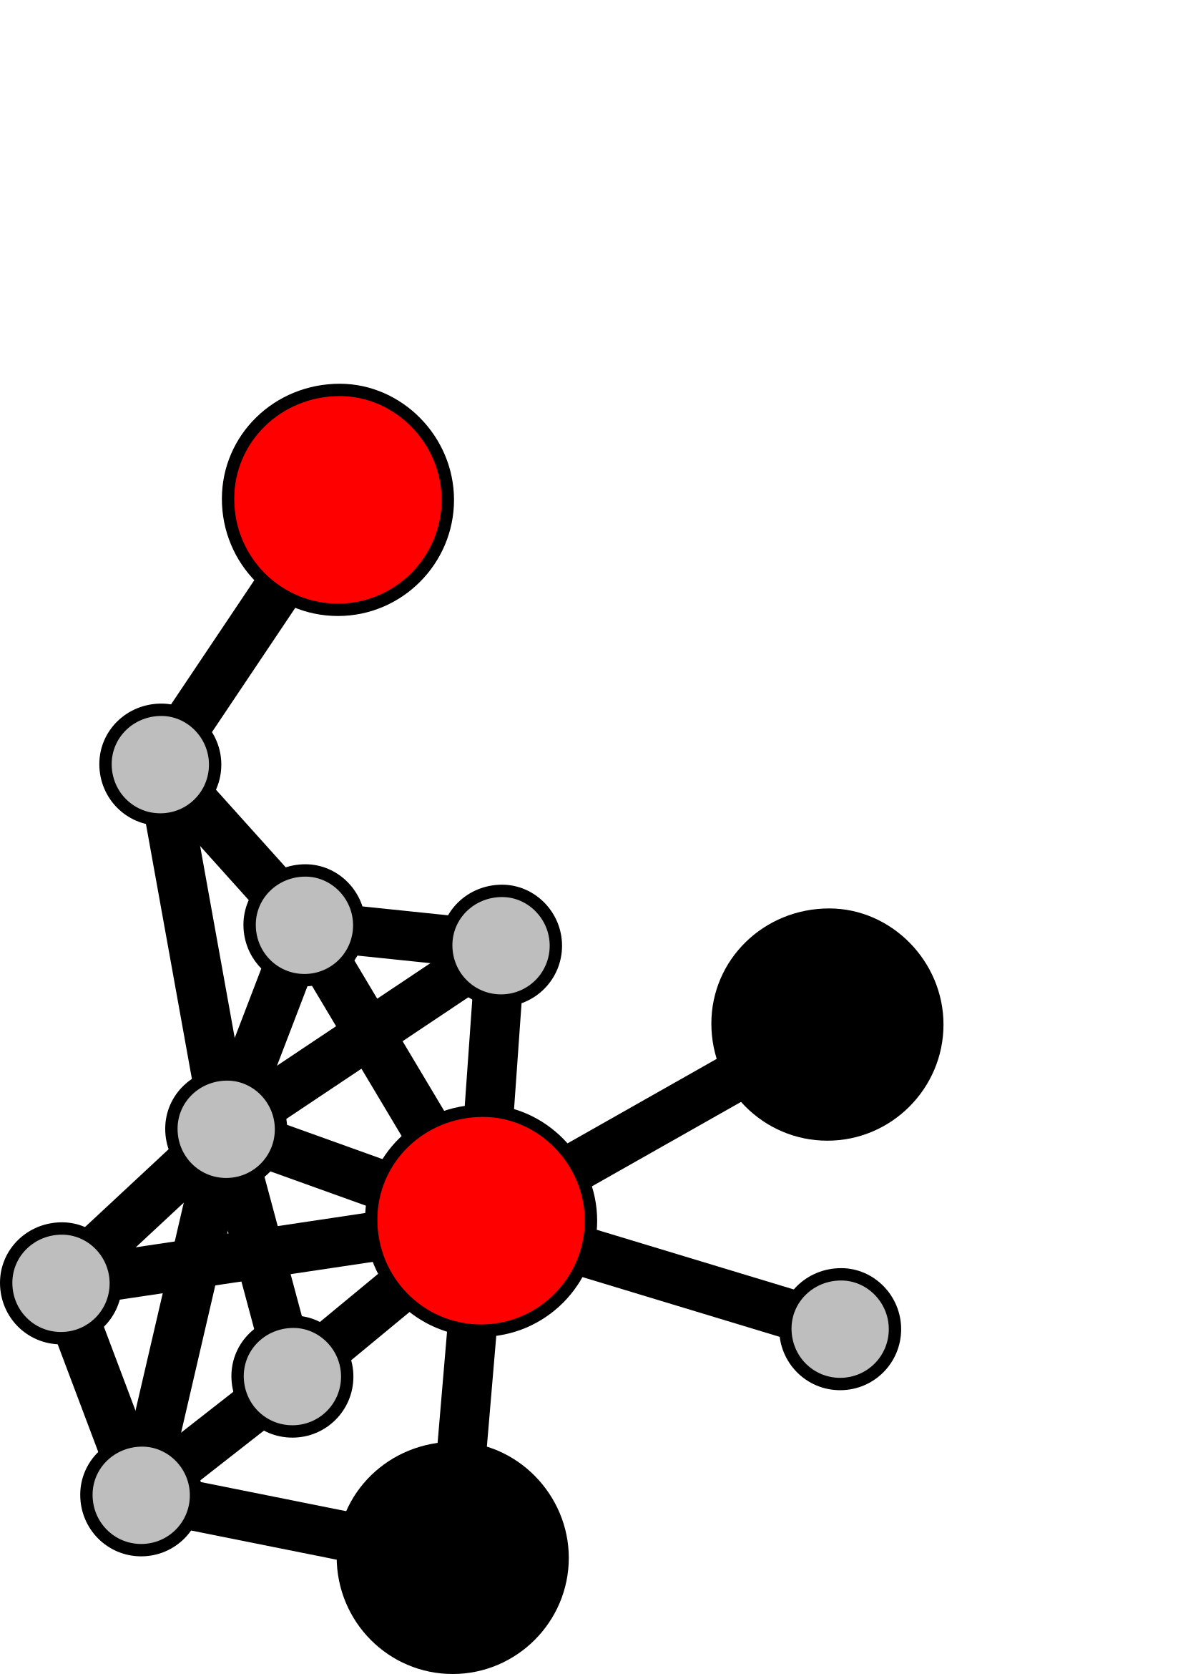

Functional Annotation
Lesson 6: Annotating with the KOALAs and KEGG database
Arkadiy Garber
Ben Tully

Slide 2
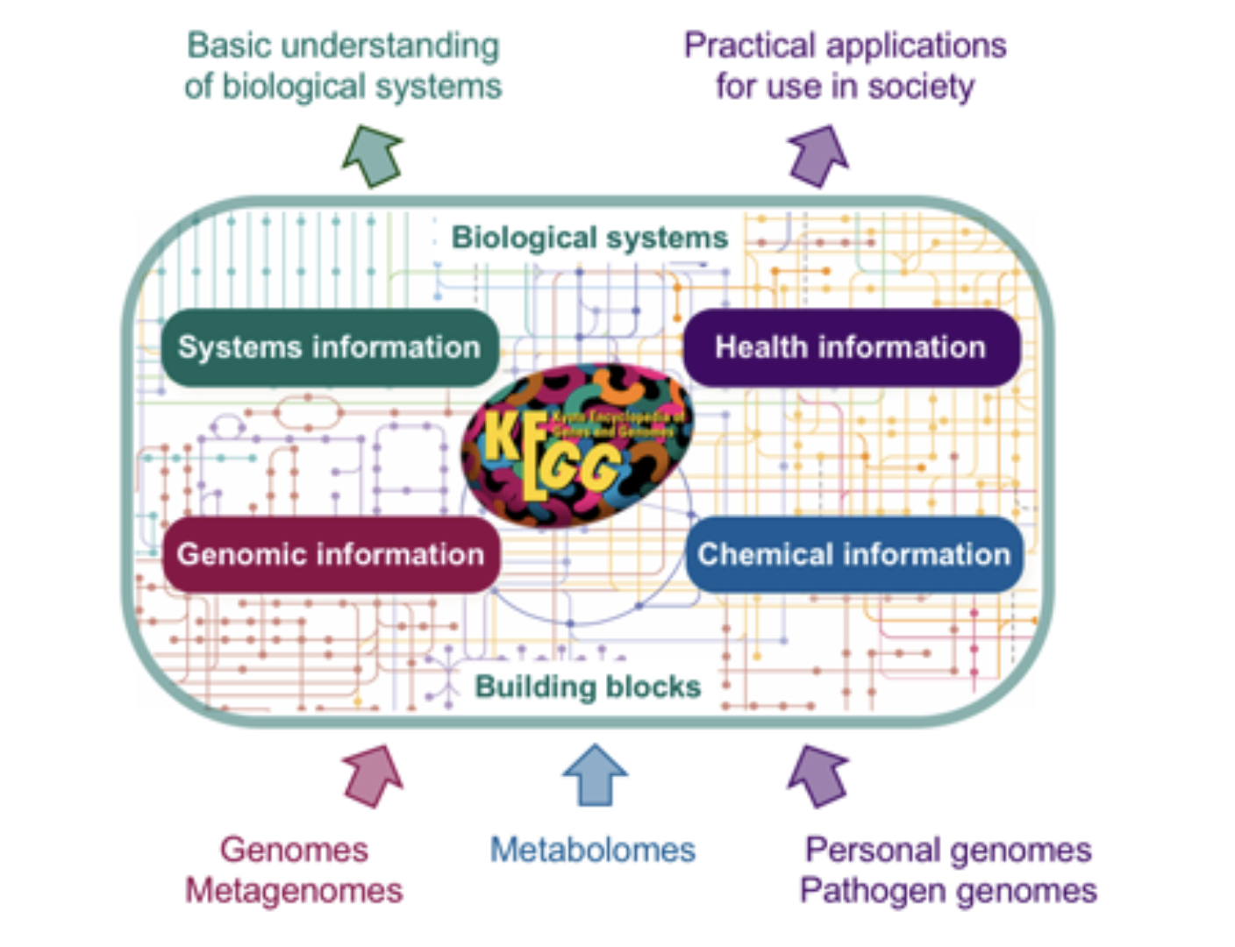

Slide 3
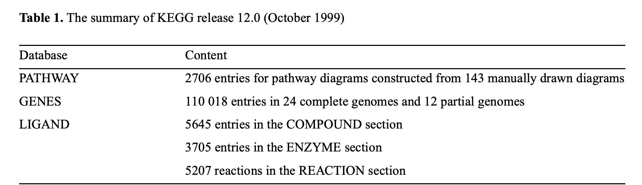
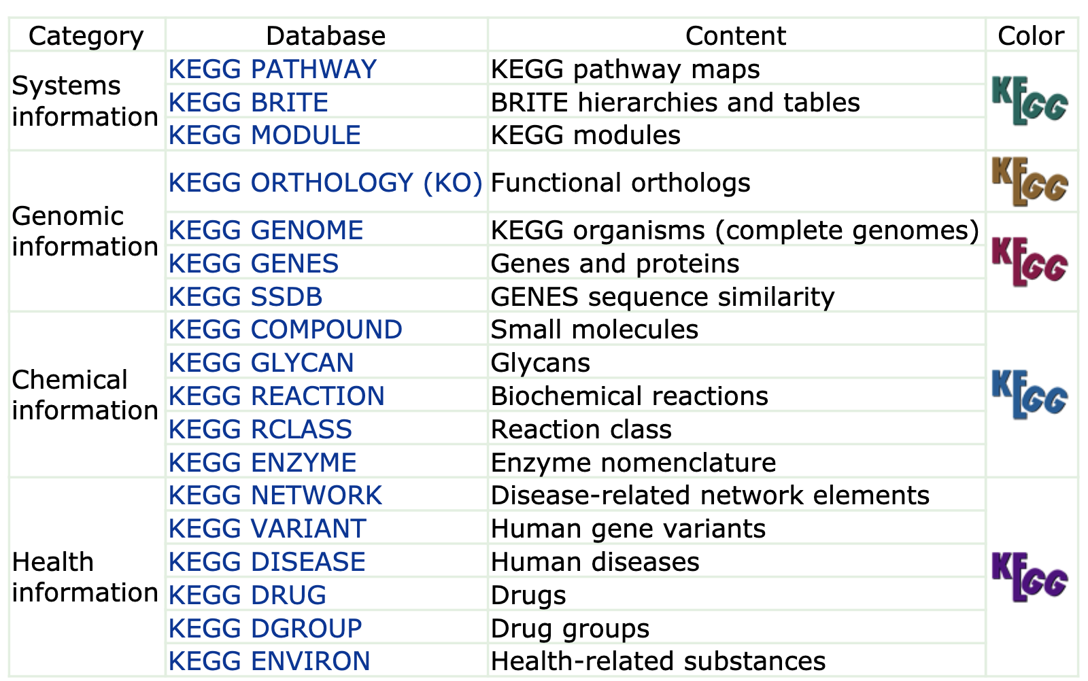

Slide 4
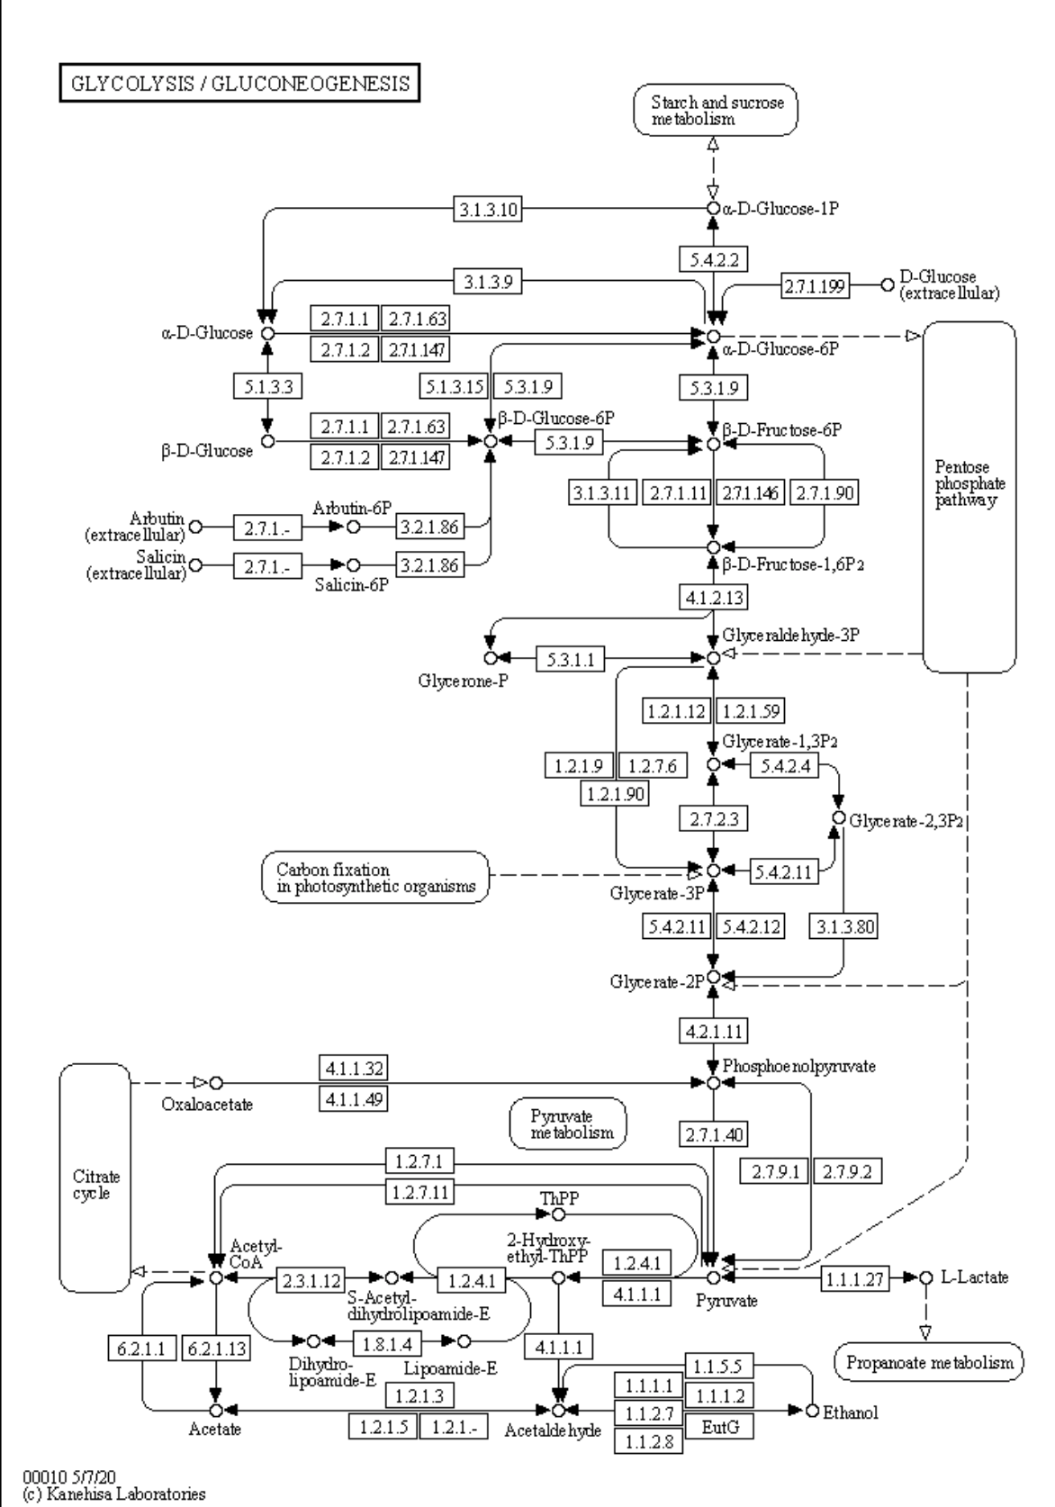
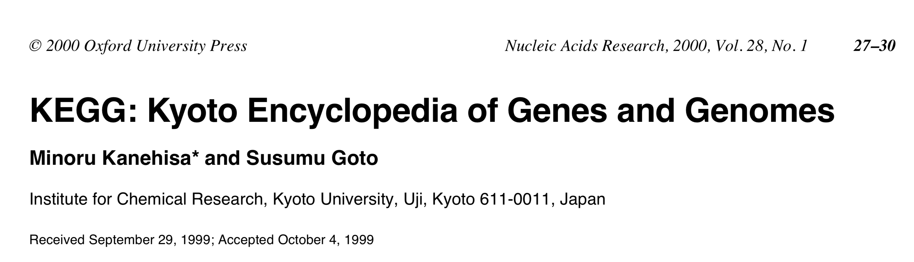
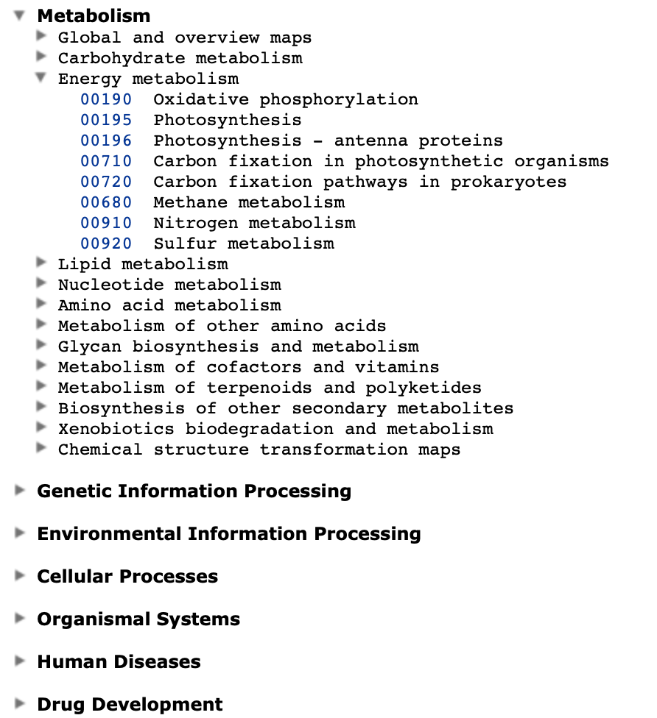

Slide 5
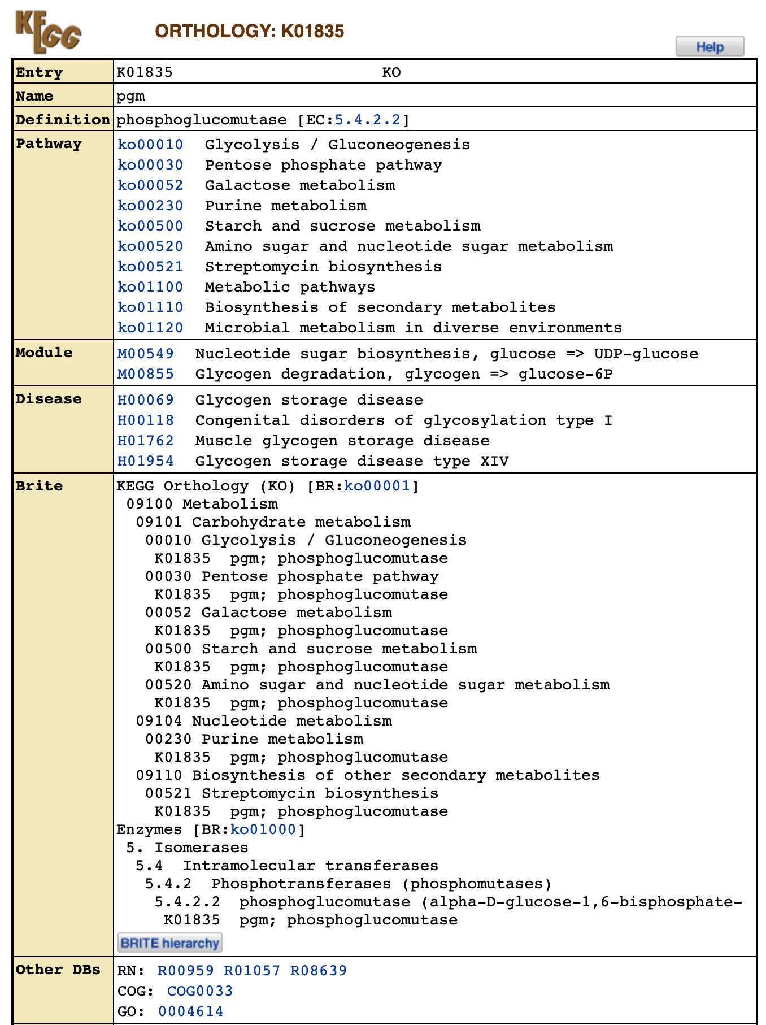

Slide 6
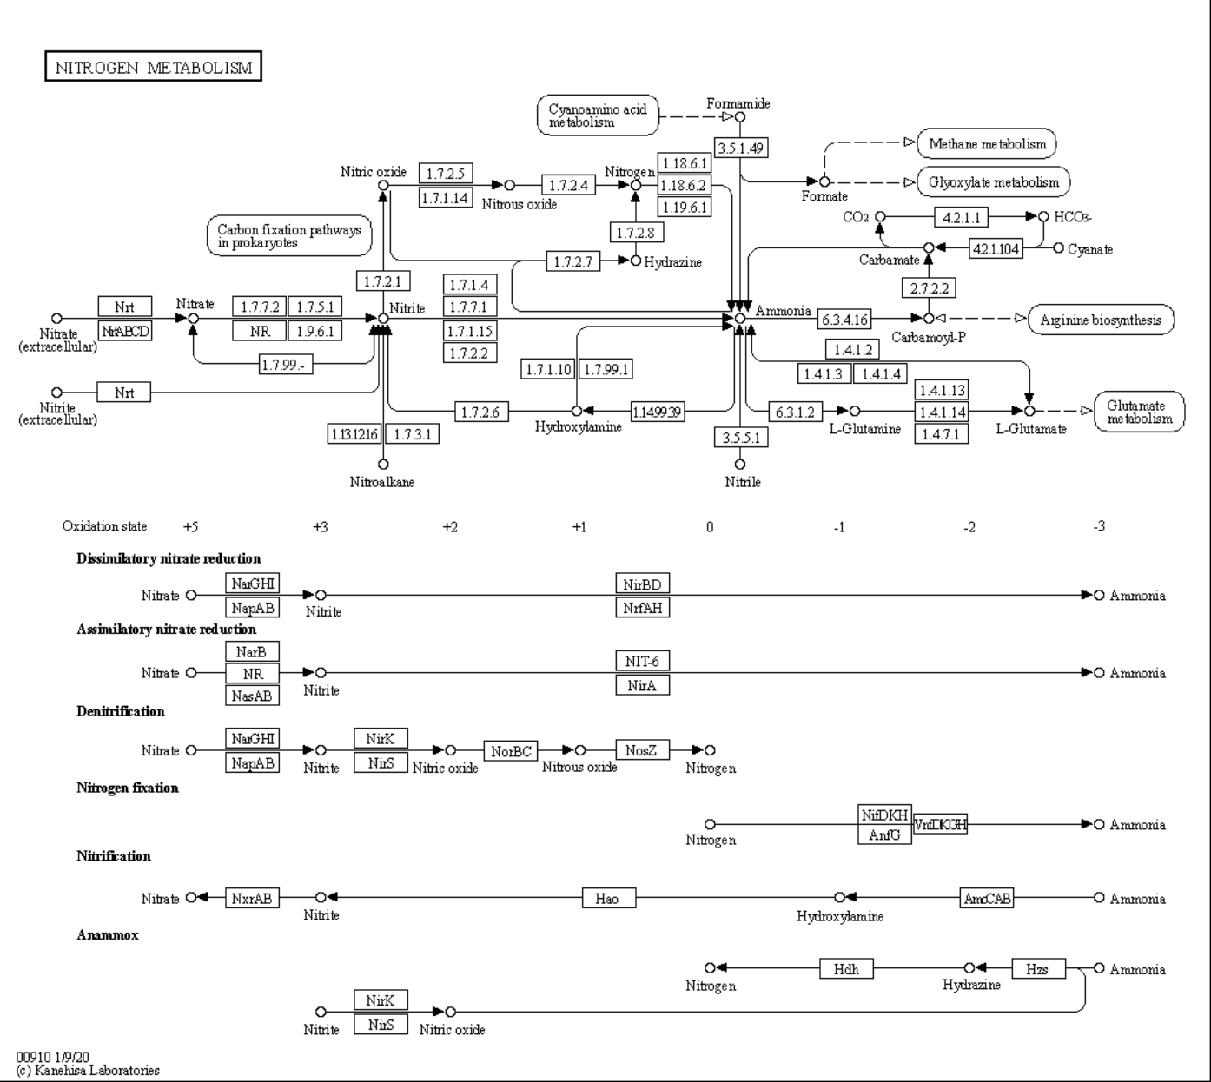

Slide 7
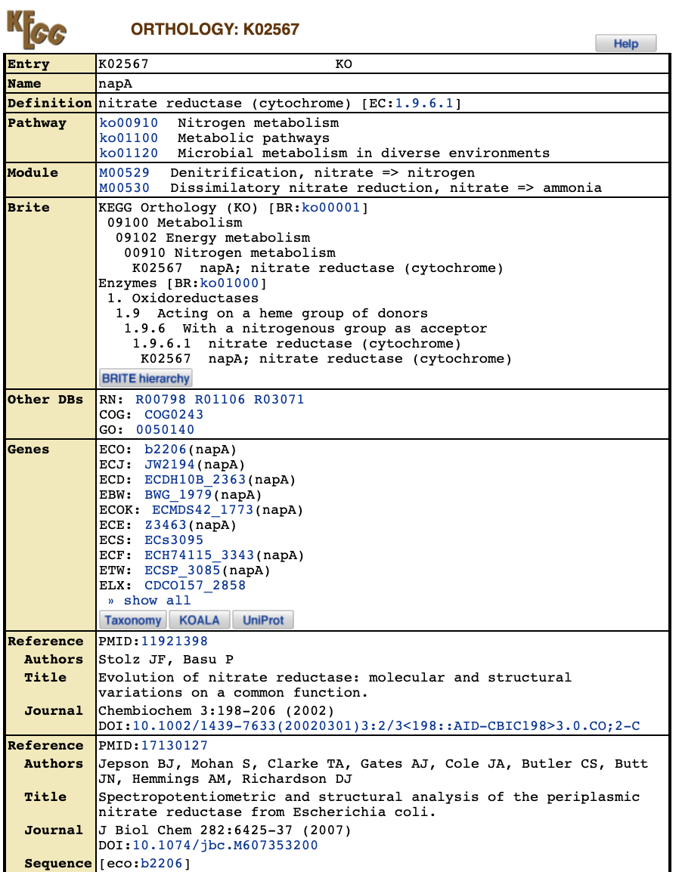
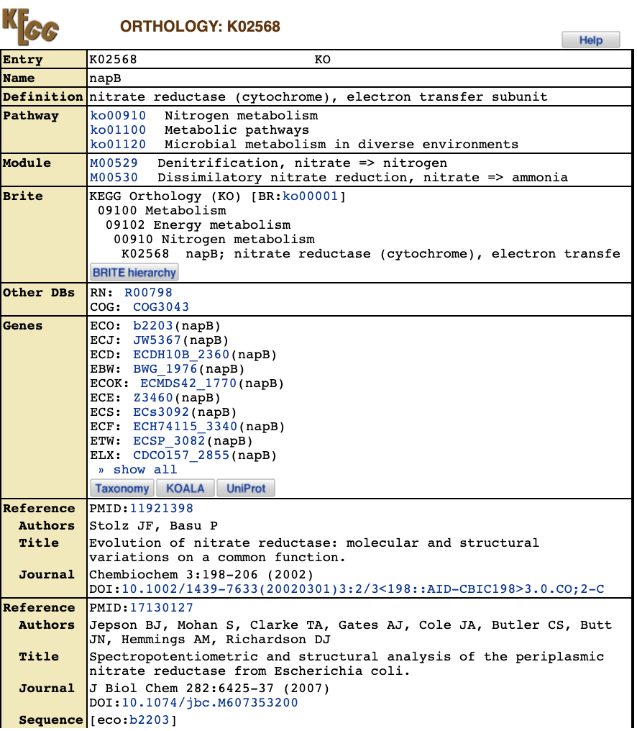

Slide 8
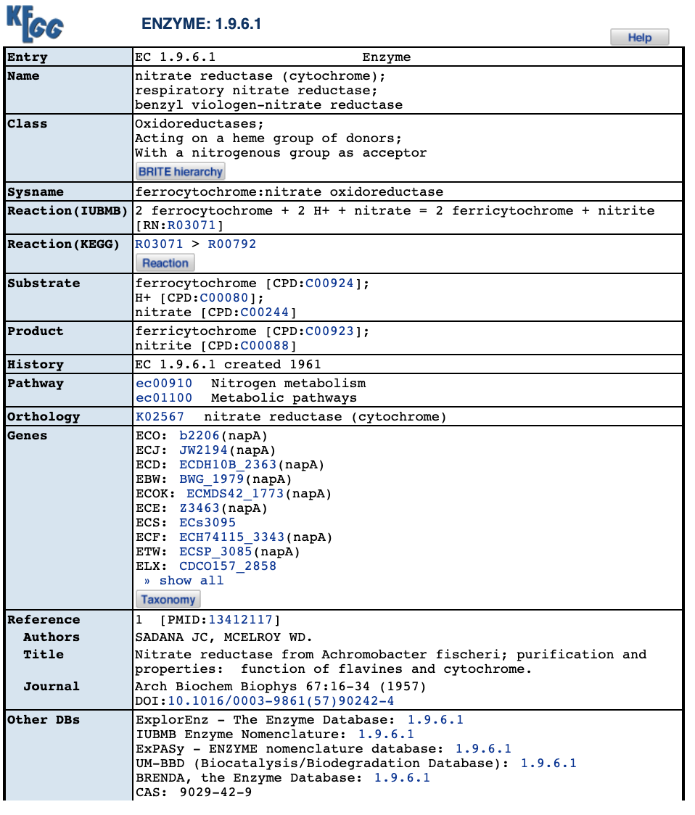
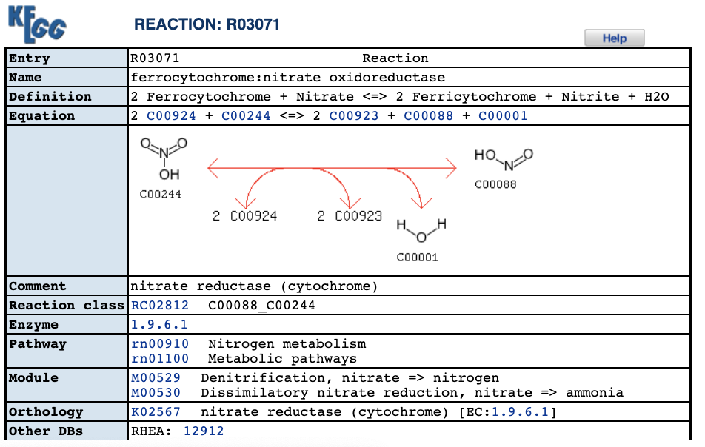

Slide 9
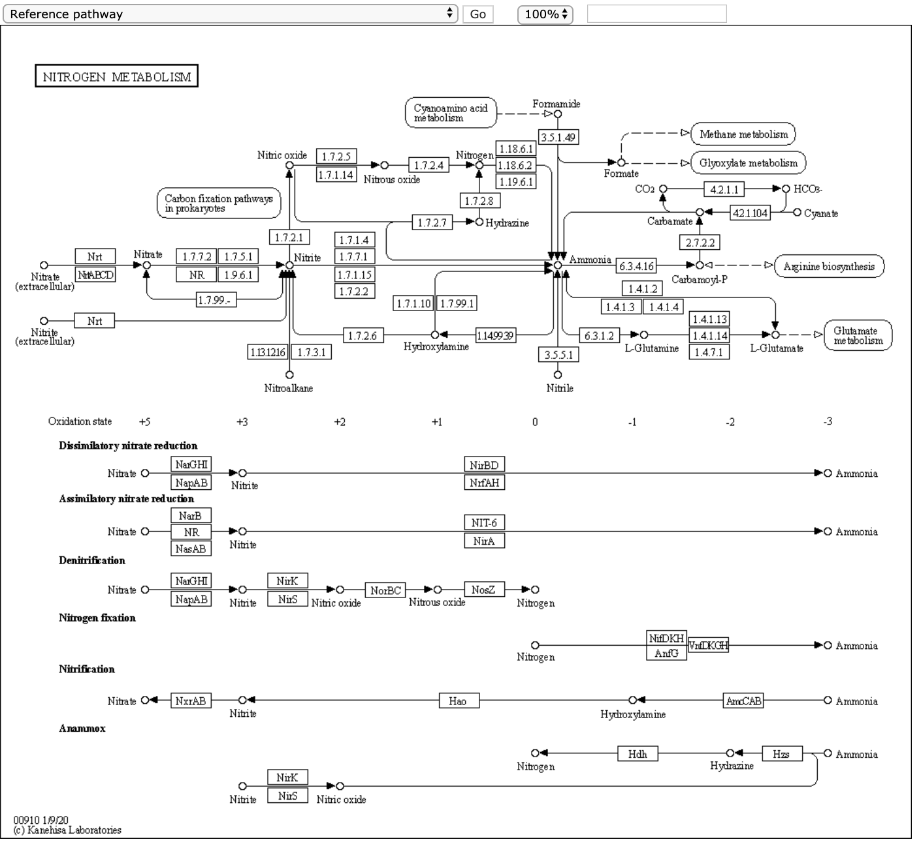

Slide 10
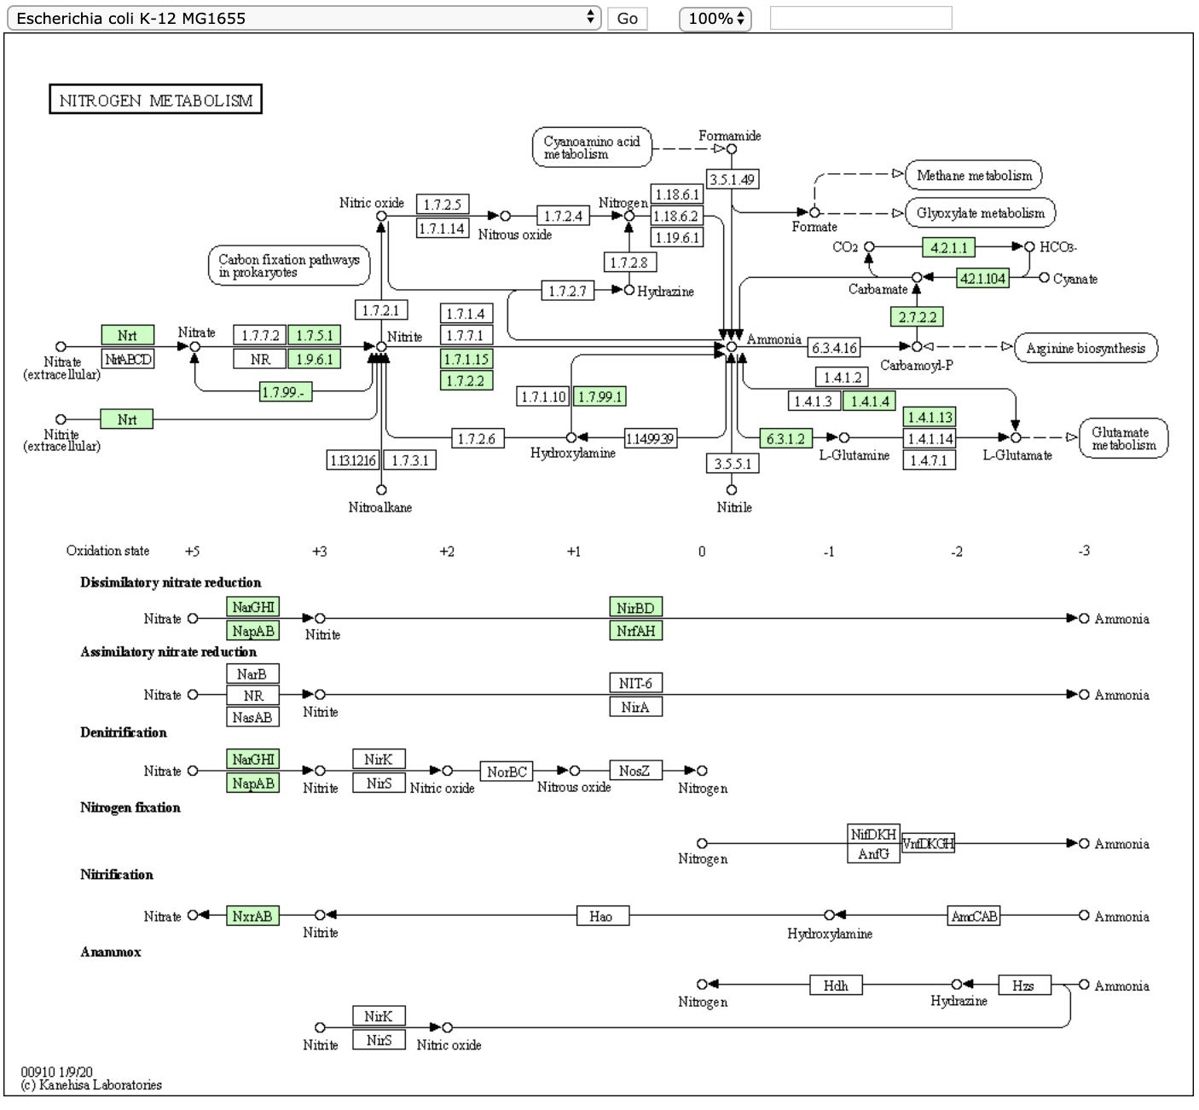

Slide 11
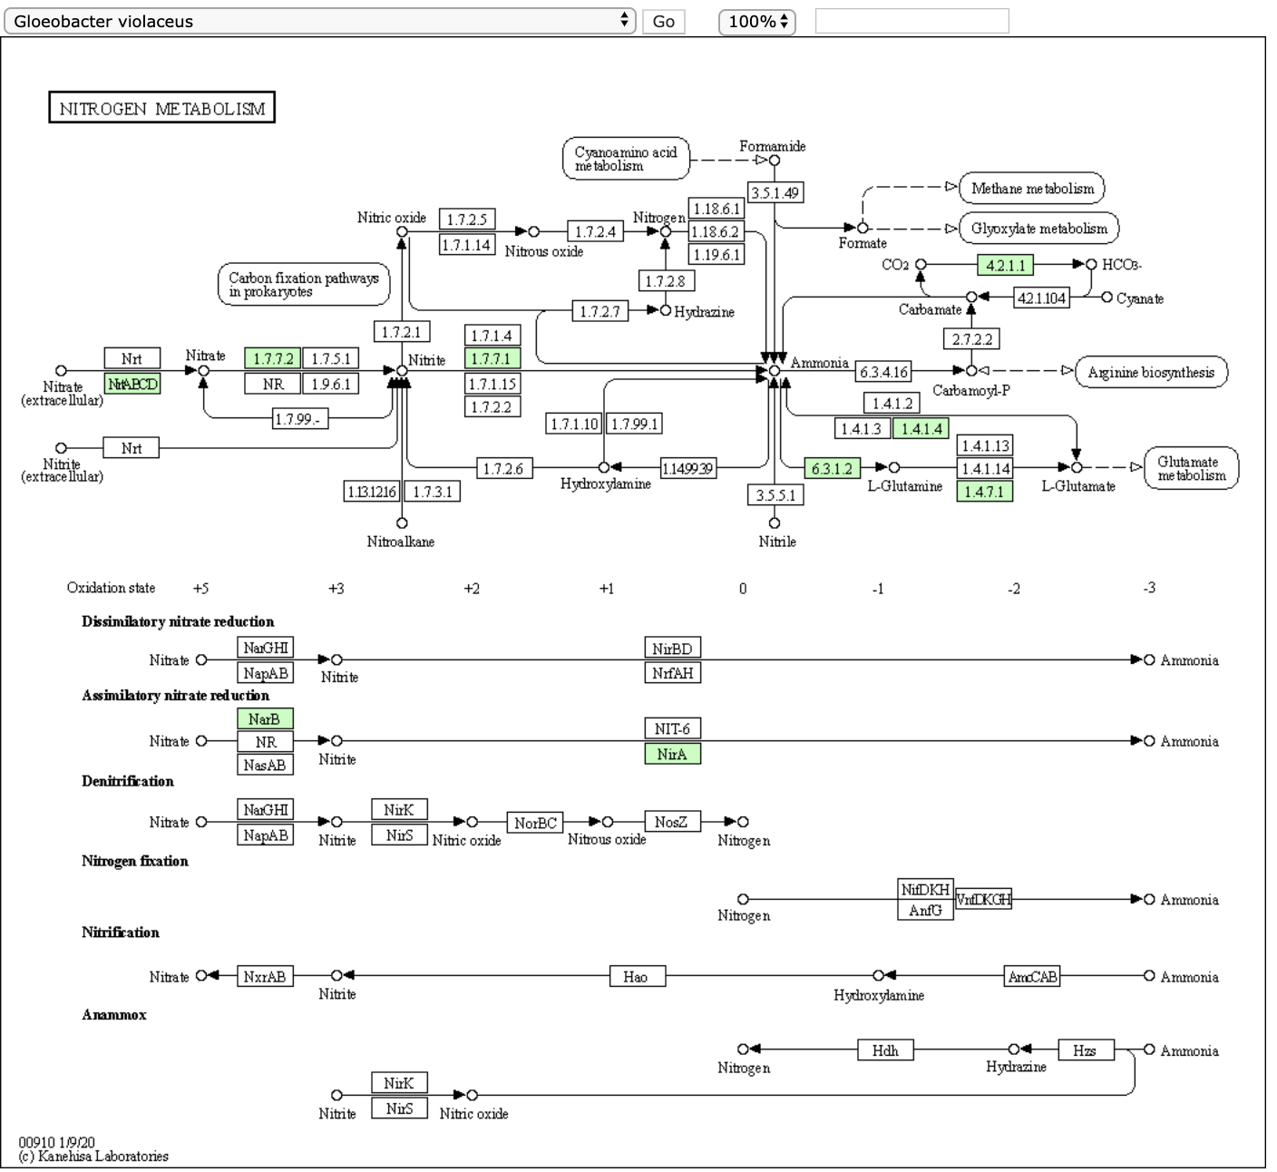

Slide 13
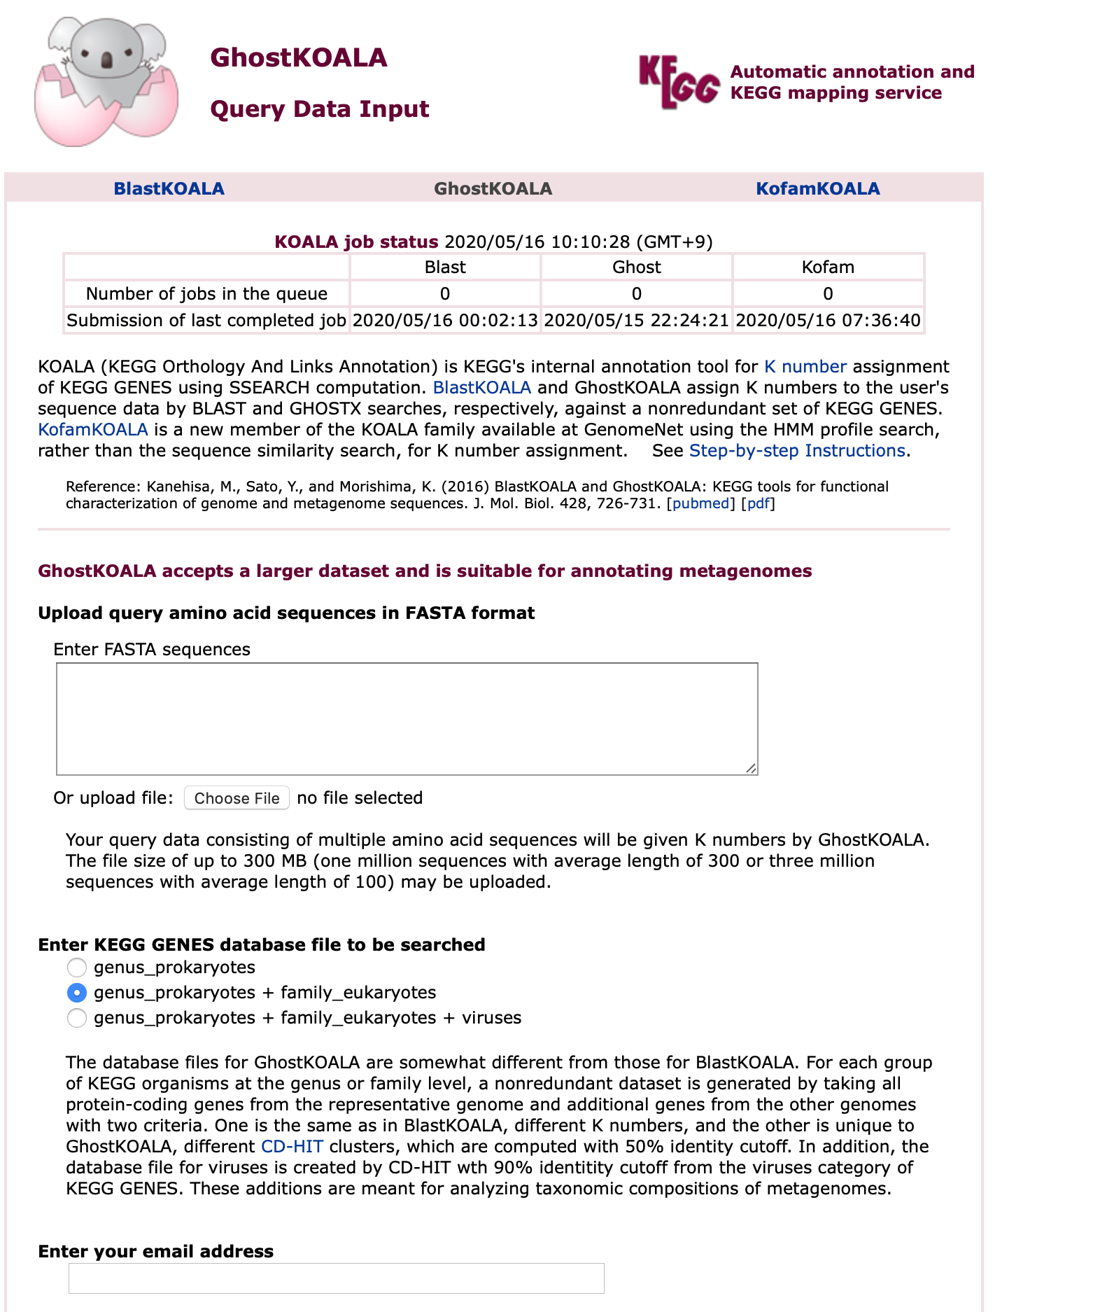
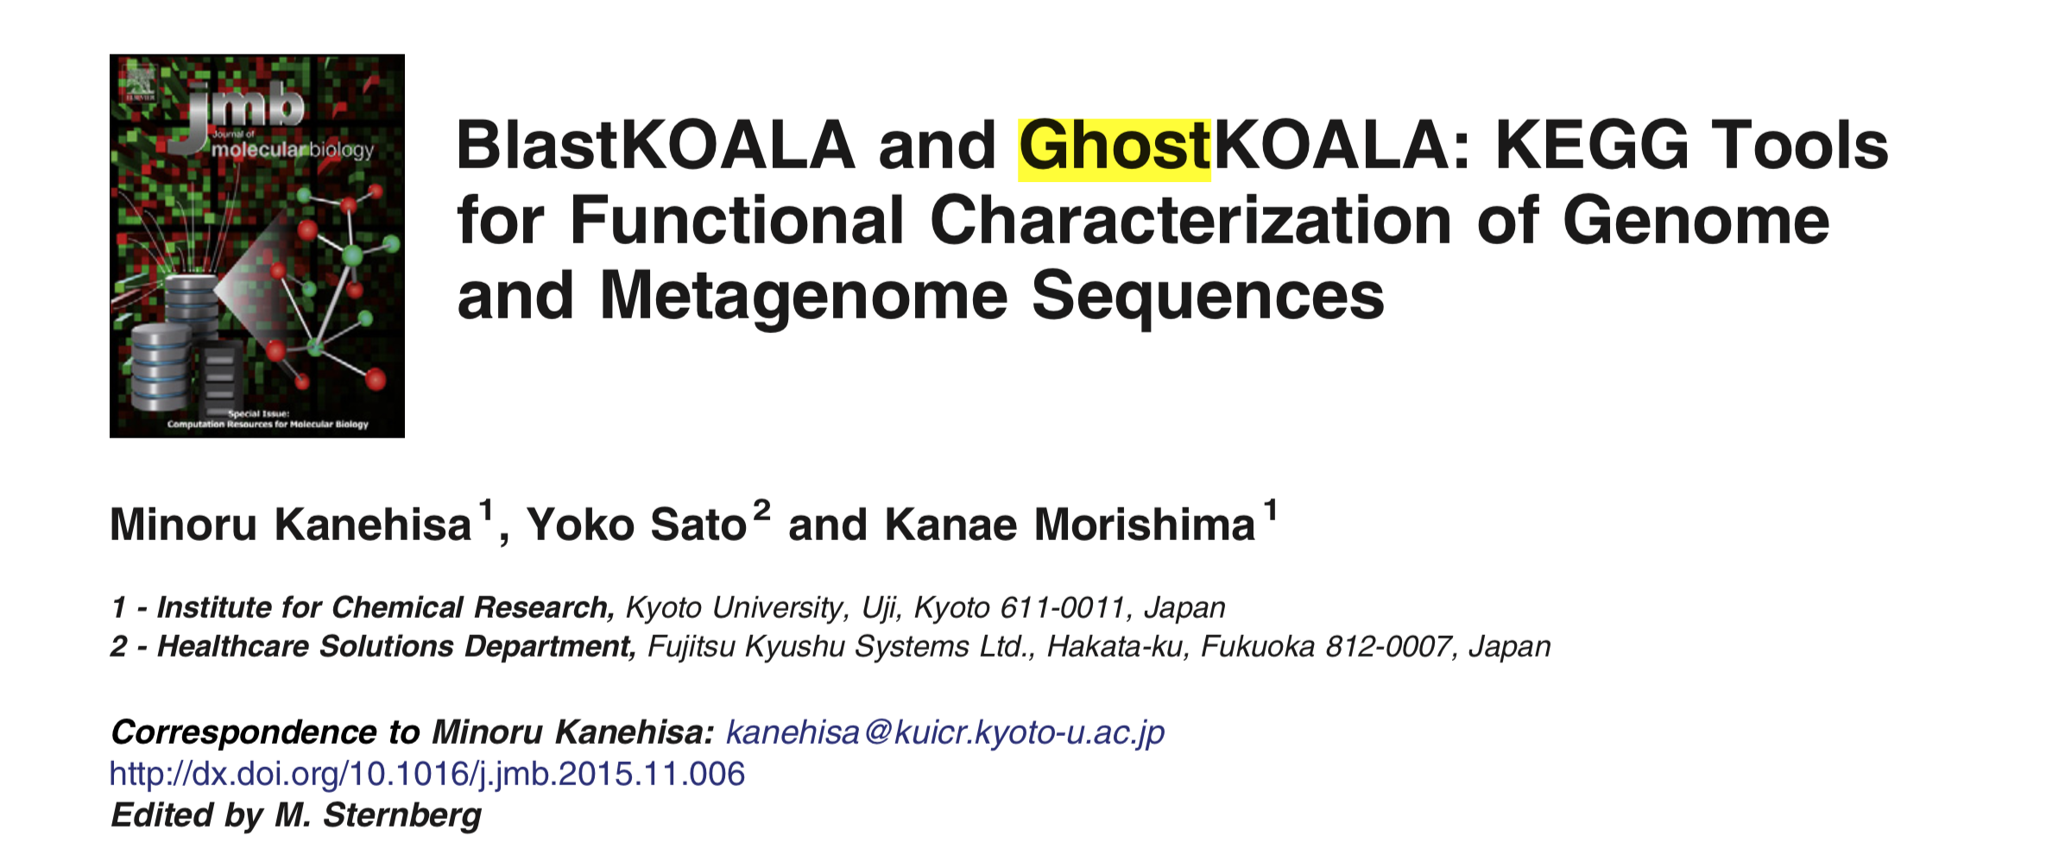
BlastKOALA, GhostKOALA, and KofamKOALA

Slide 14

BLASTx vs GHOSTX
GHOSTX about 50 times faster than BLASTx

Slide 15
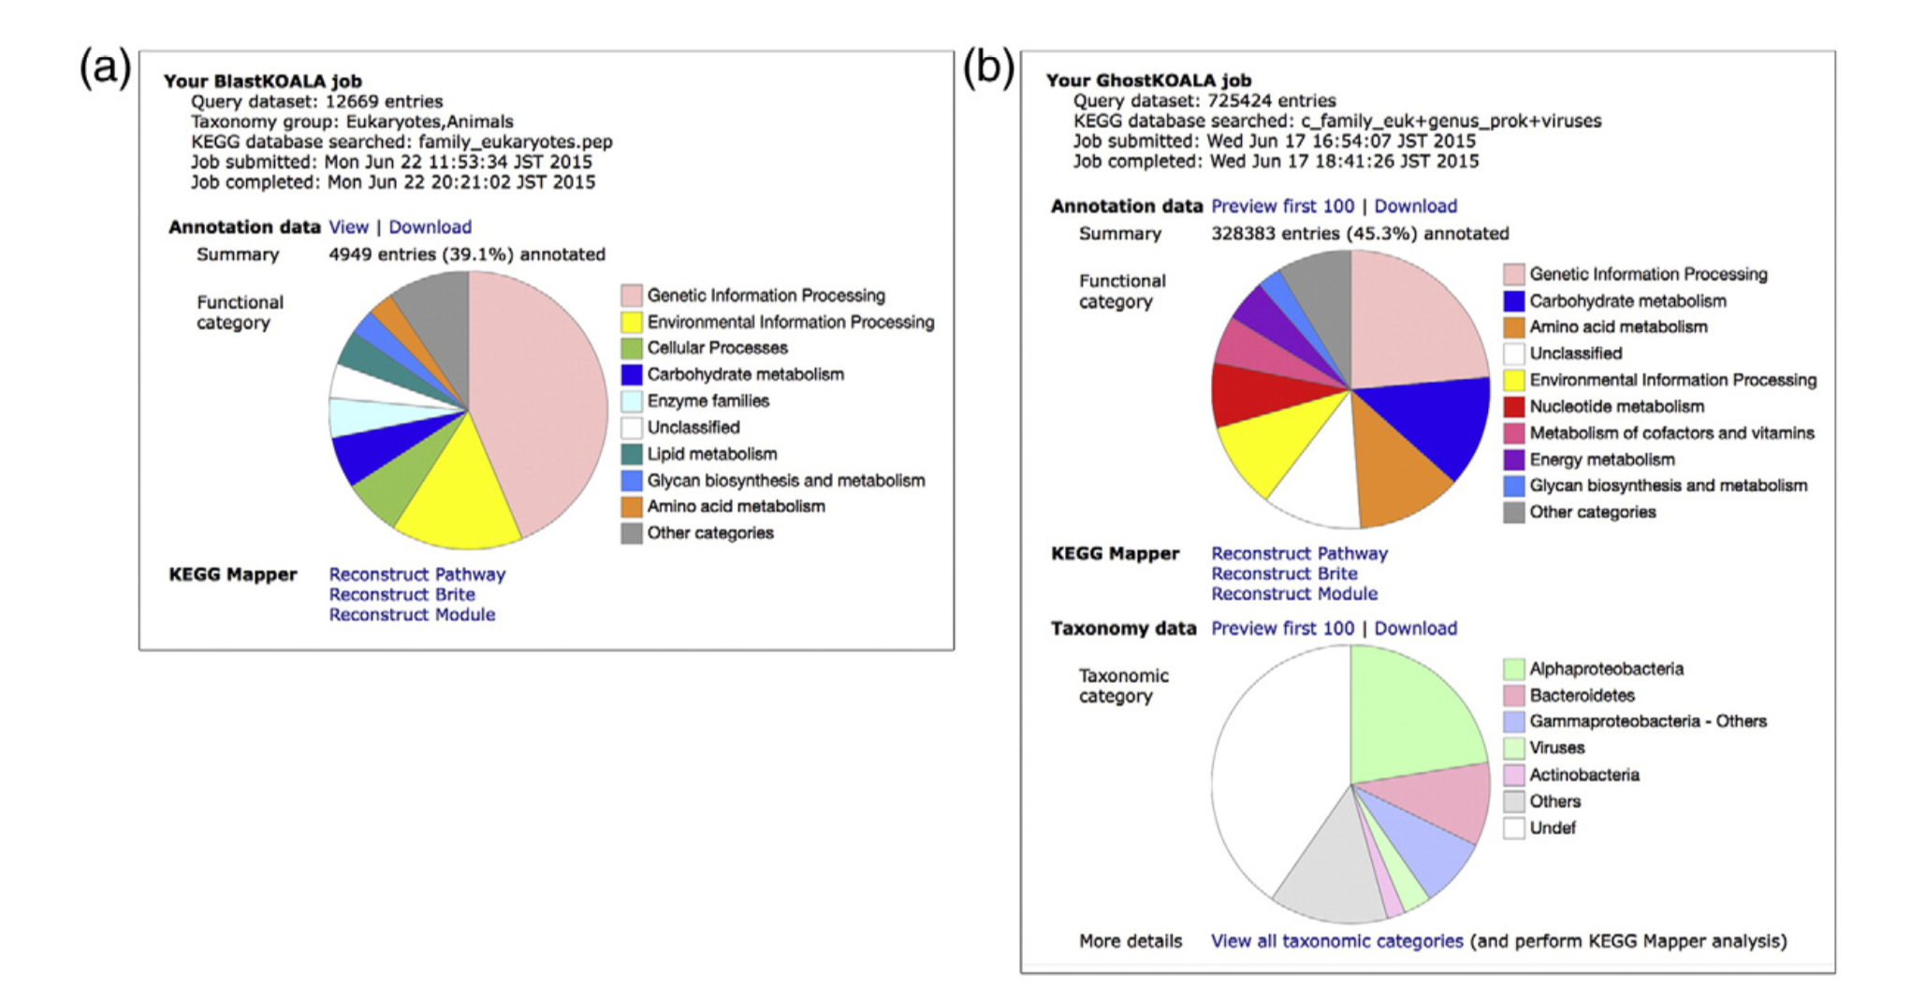
BlastKOALA and GhostKOALA output

Slide 16
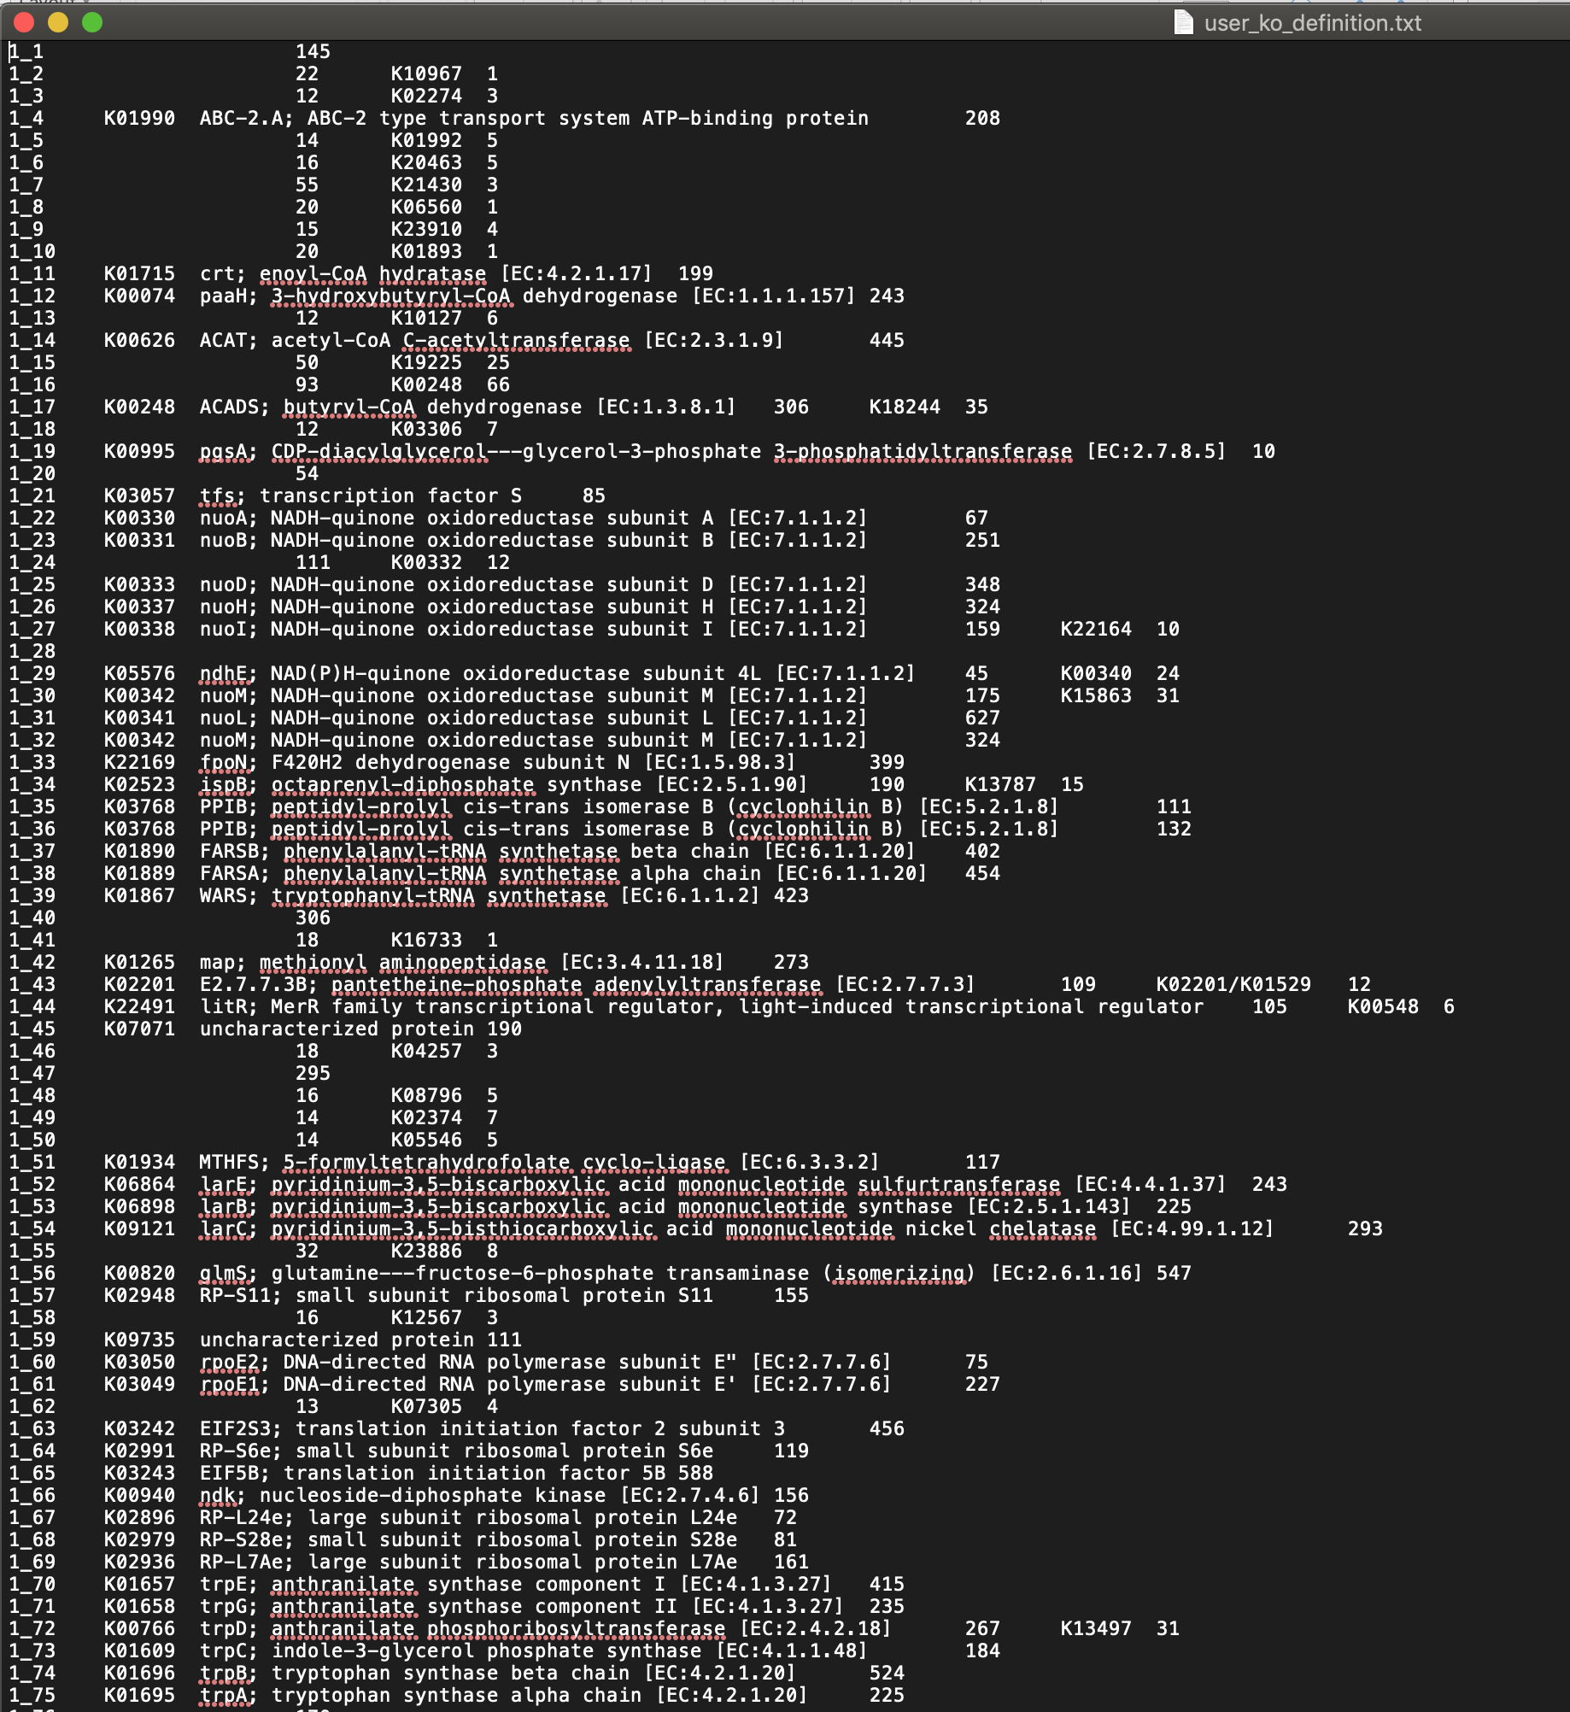
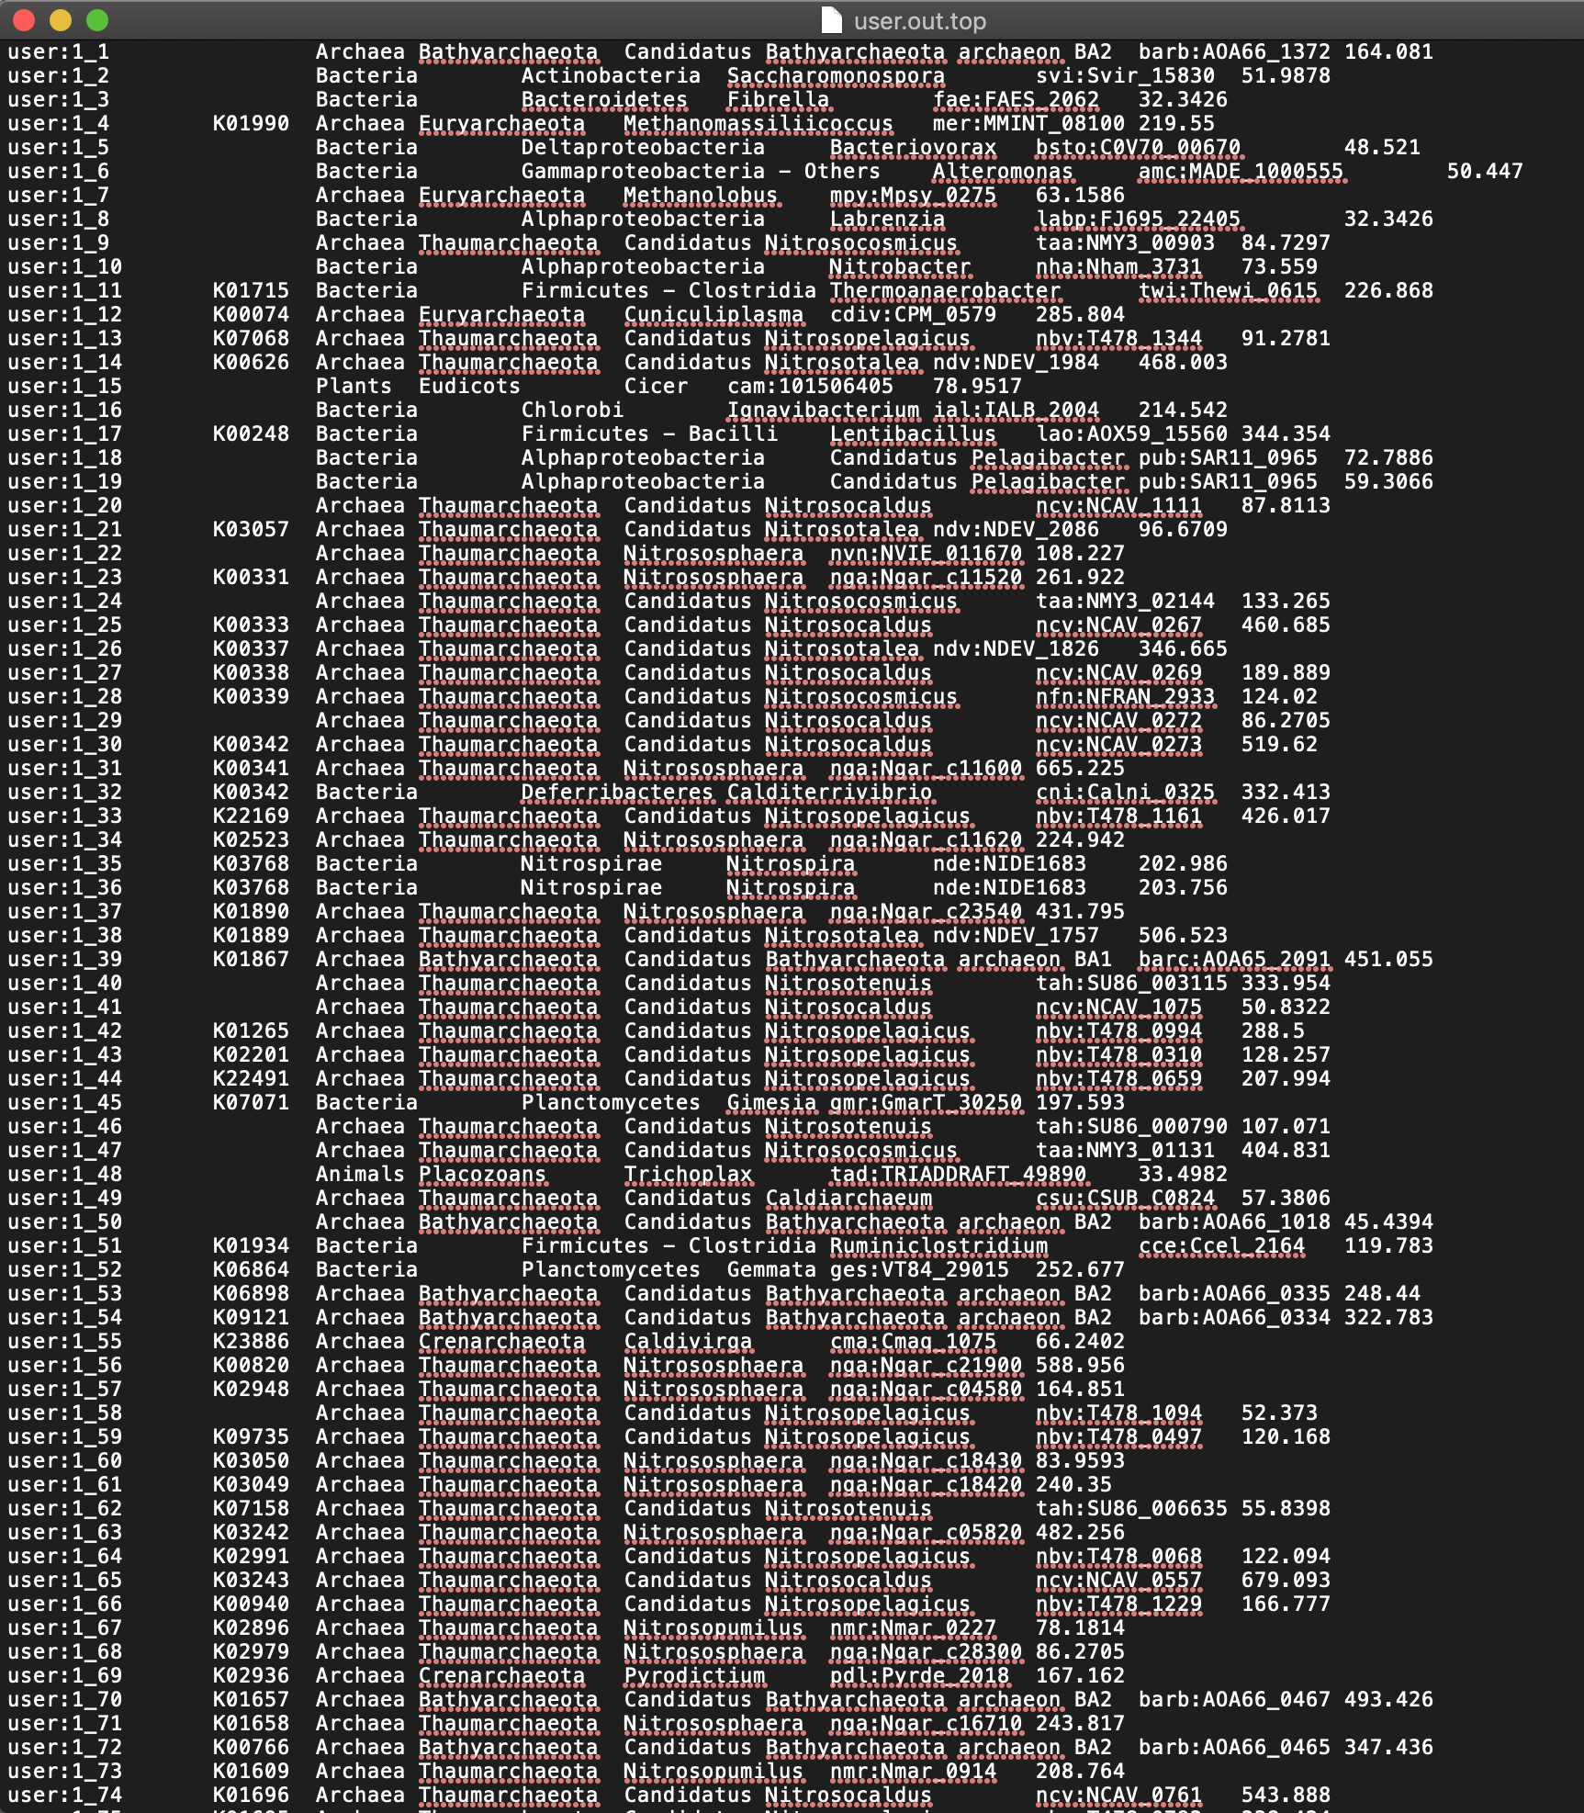
GhostKOALA raw output

Slide 17
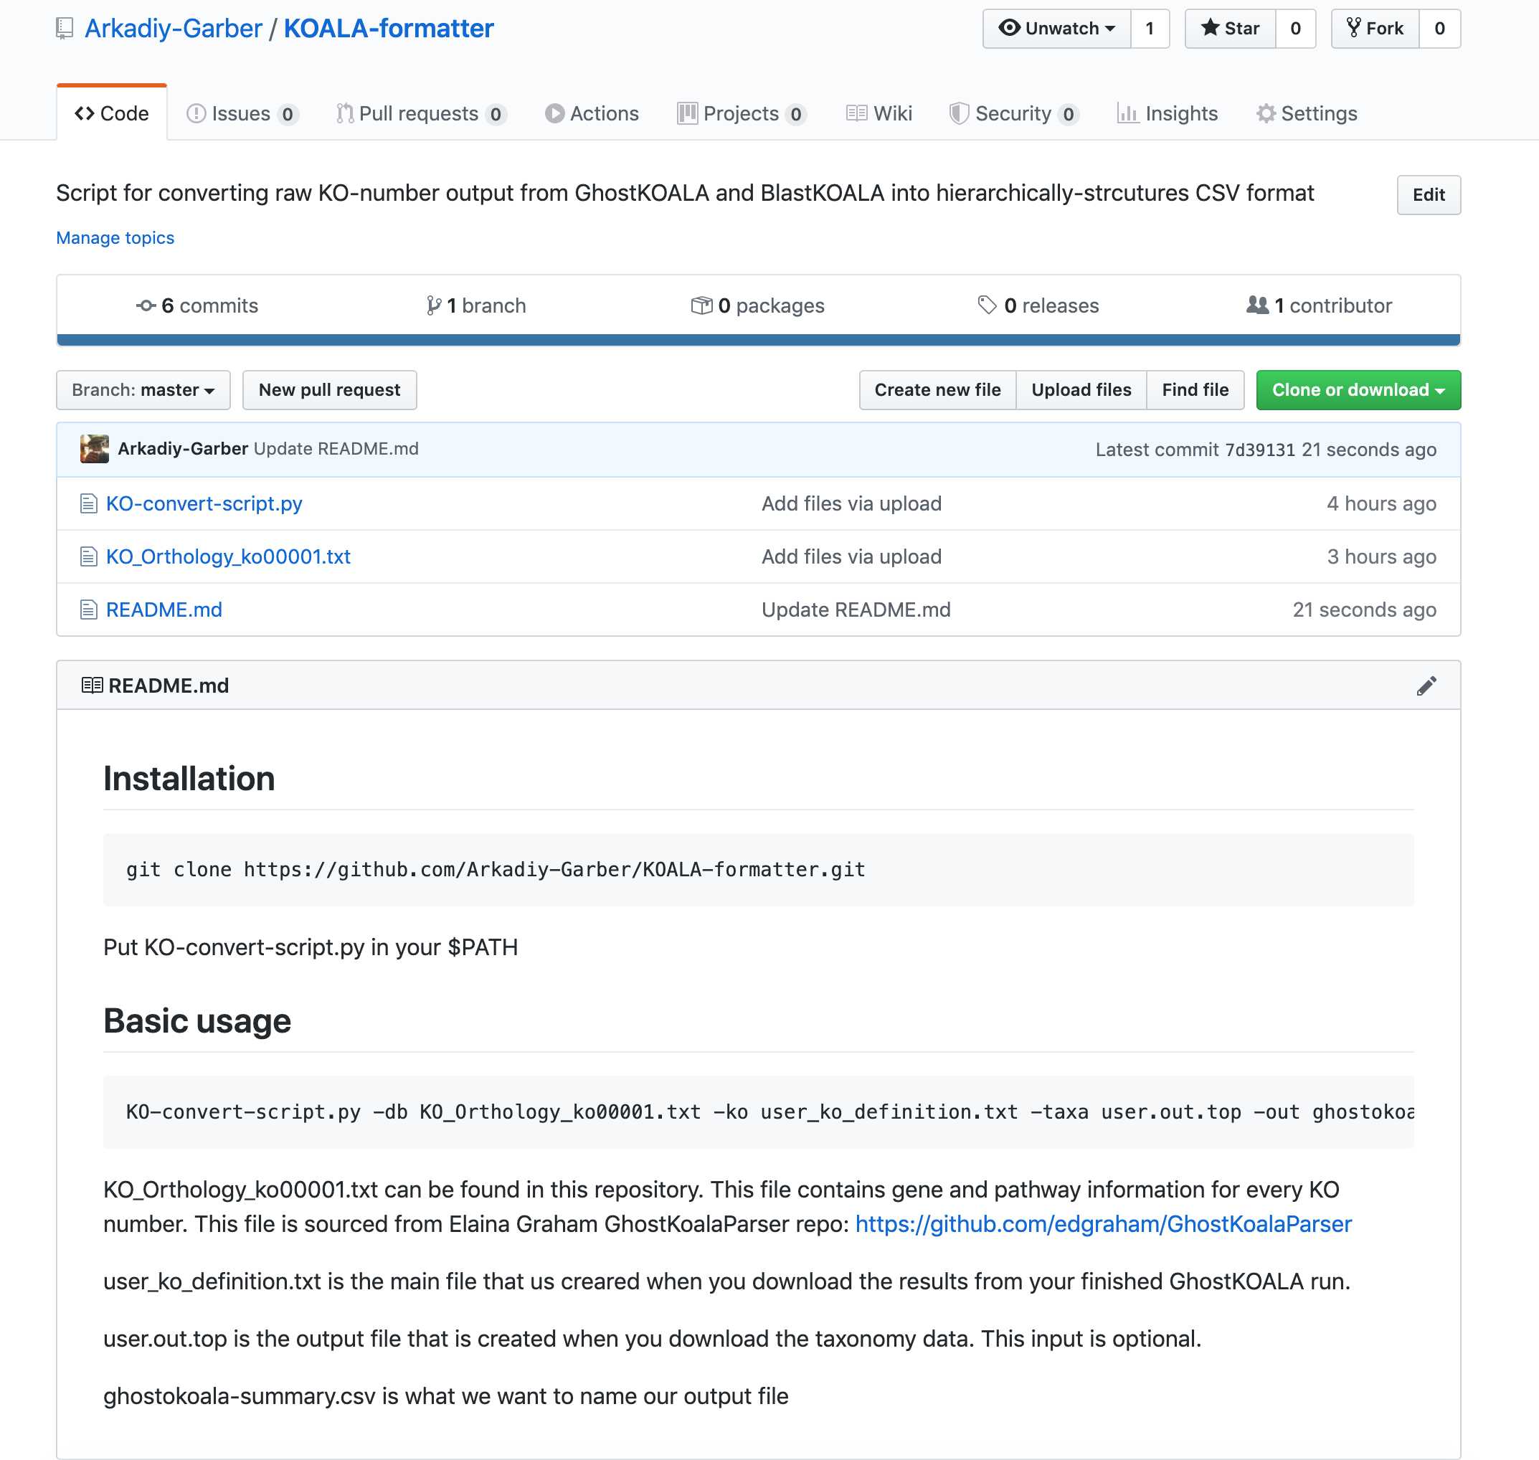
Incorporation of GhostKOALA results into Anvio’s metagenomic workflow

Slide 18
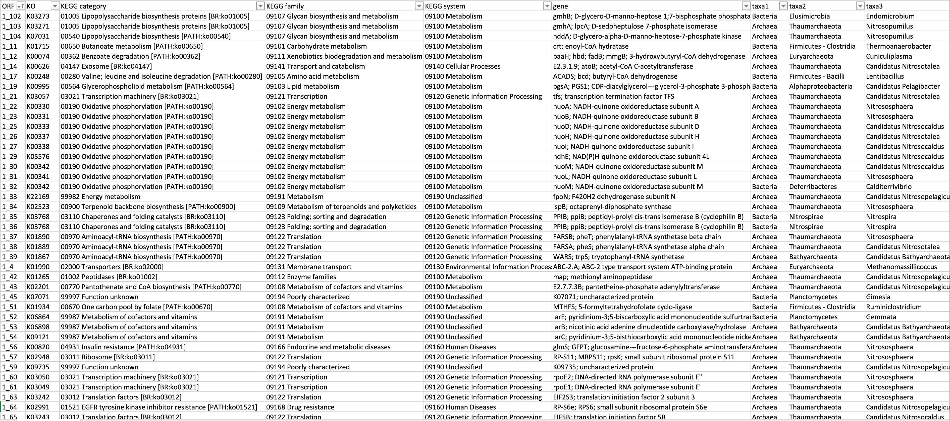
What does the final output look like?

Slide 19
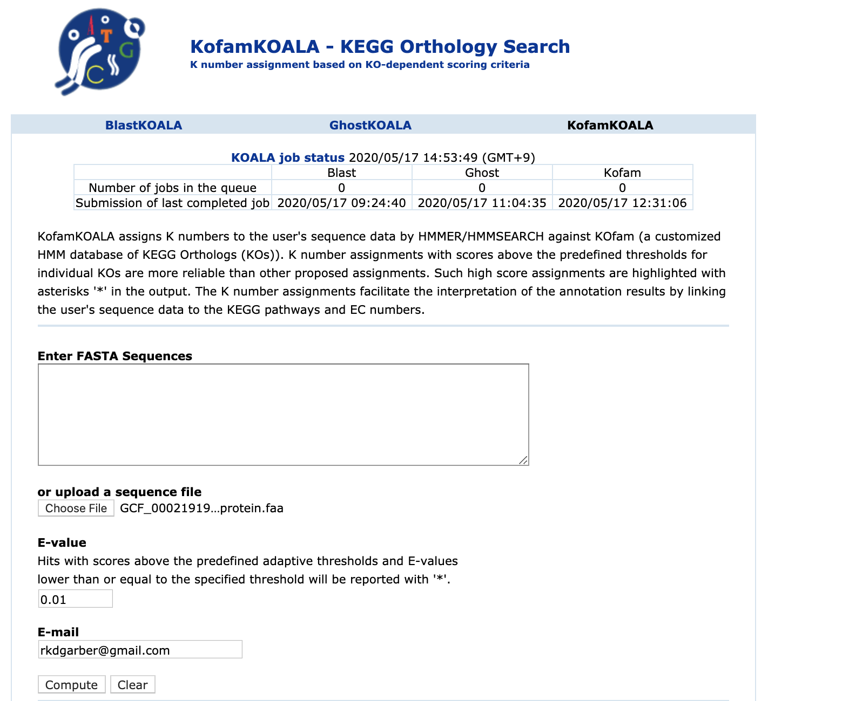
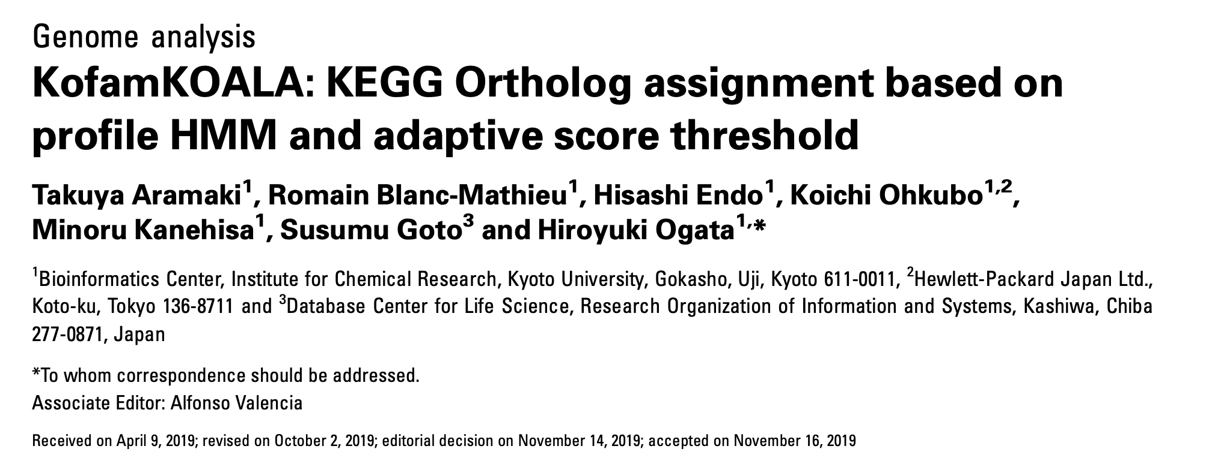
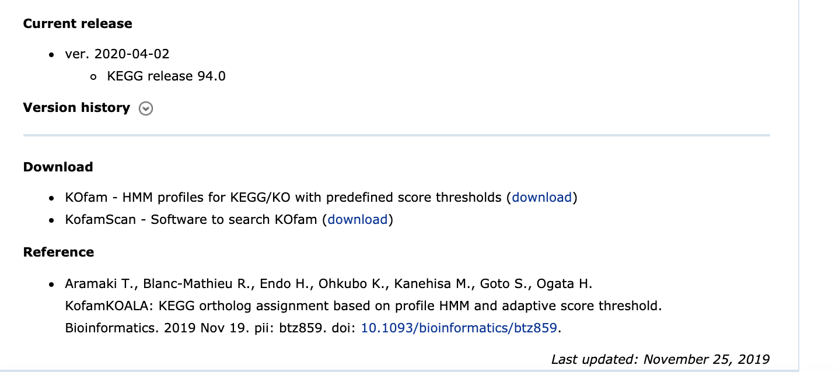
KOfamscan about 83 times faster than BLASTx
About twice as fast as GHOSTX

Slide 20
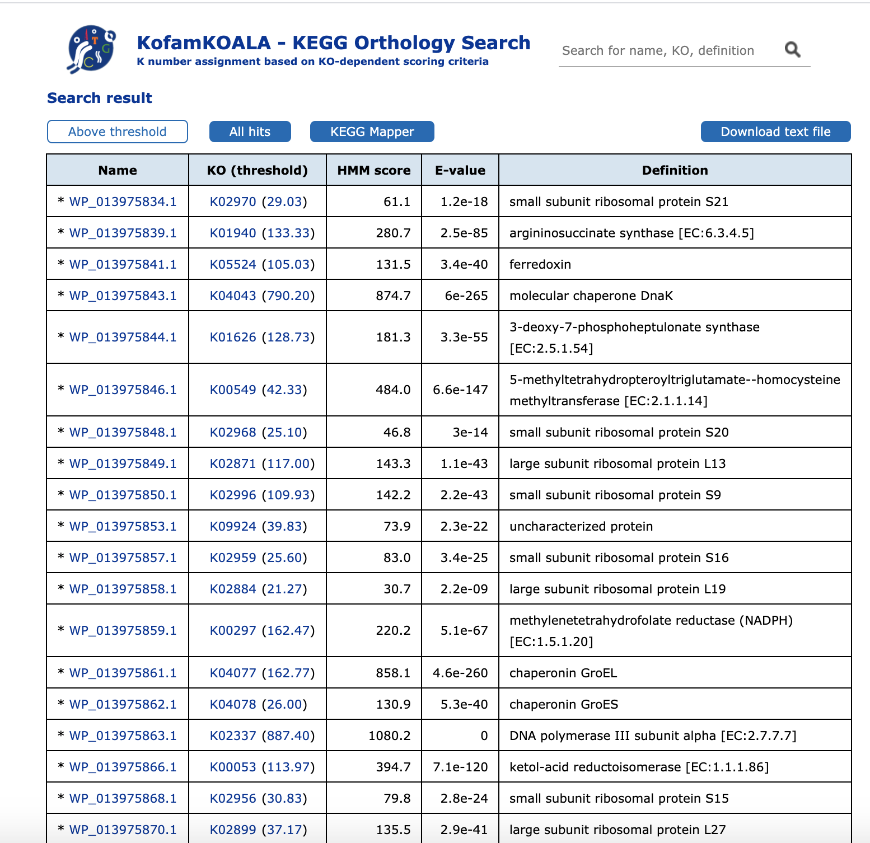

Slide 21
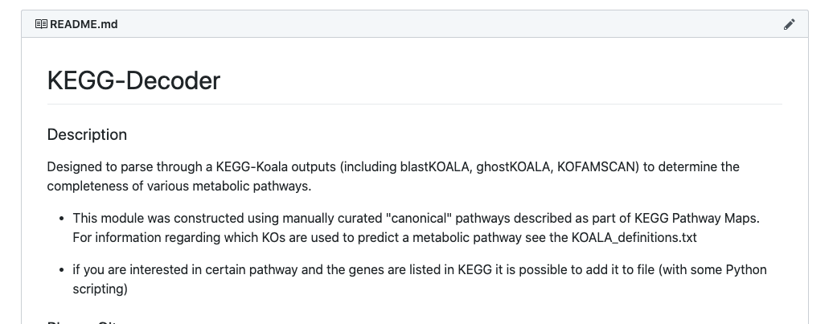
KEGG-Decoder: Evaluation and visualization KEGG KOALA output
https://github.com/bjtully/BioData/tree/master/KEGGDecoder

Slide 22
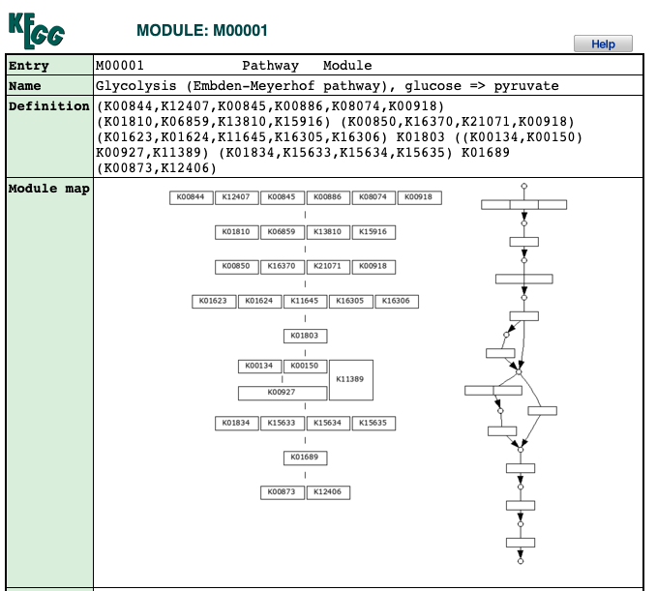
KEGG Modules
KEGG Decoder heatmap

Slide 23
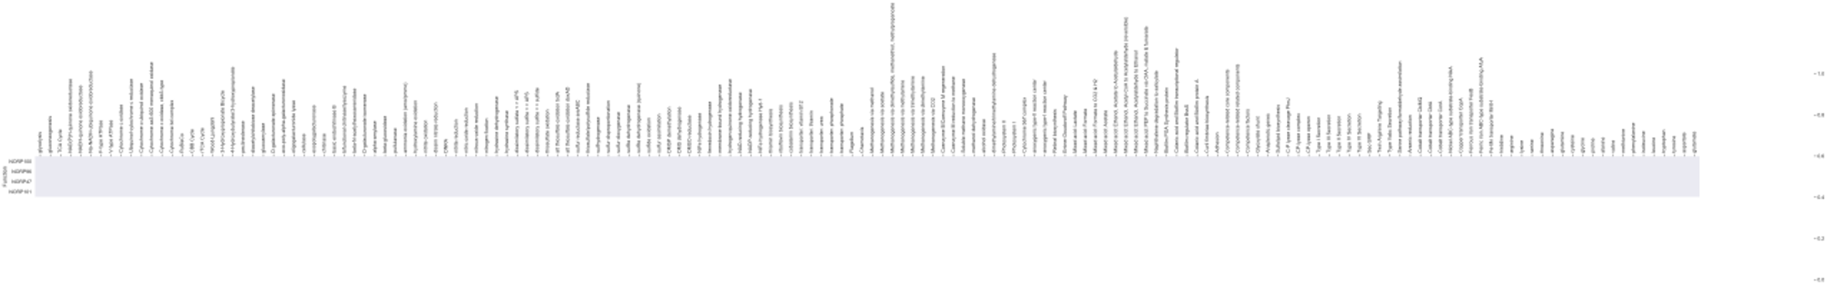
KEGG-Decoder
methanogenesis
secretion systems
amino acid biosynth
Vitamins & transporters
fermentation
core metabolism
carbon degradation
O2 cytochromes
carbon fixation
nitrogen cycle
sulfur cycle
hydrogen cycle
Designed to provide a high-level overview of metabolic processes → additional confirmation required

Slide 24
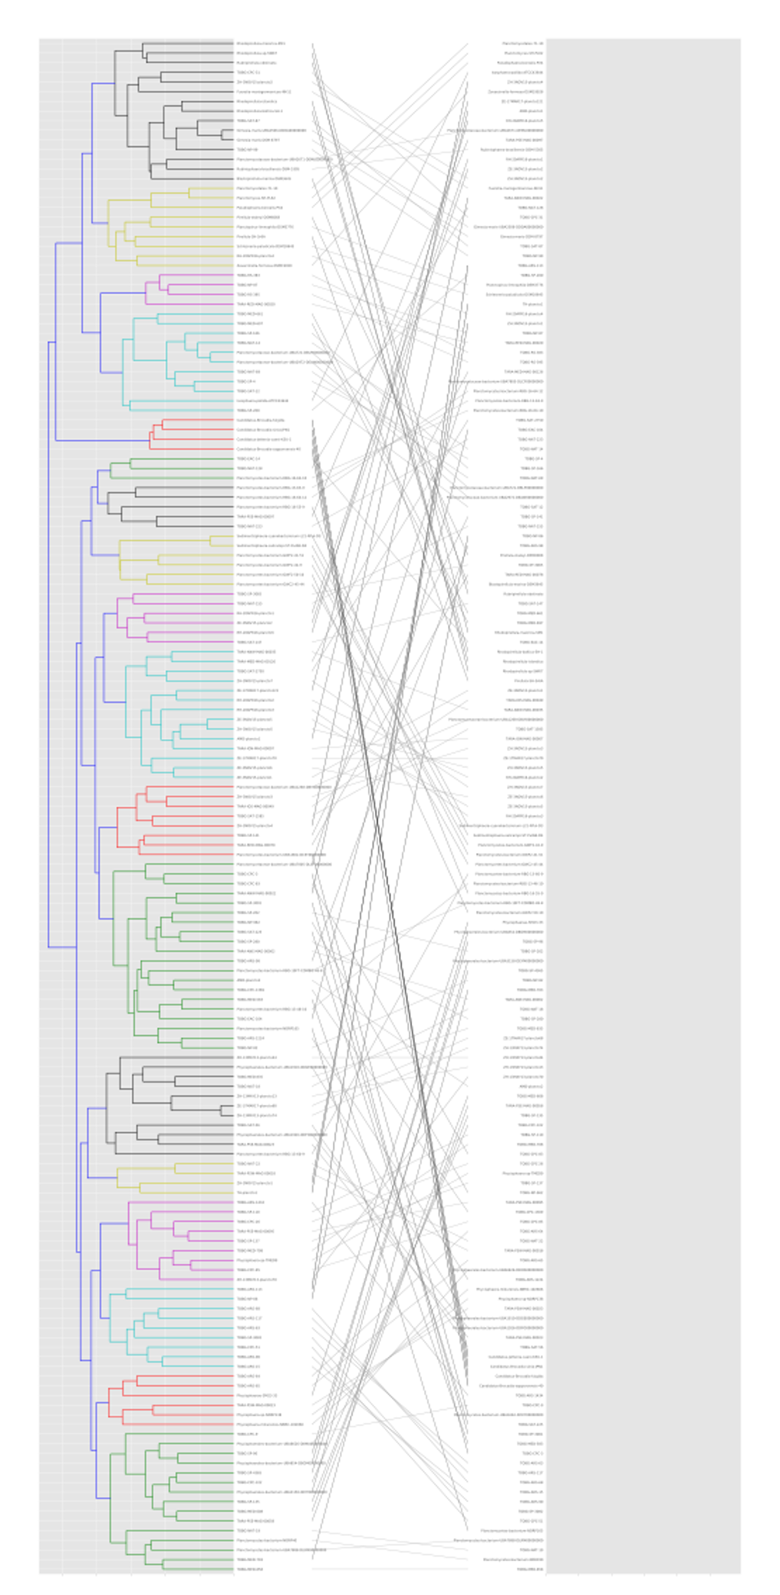
KEGG-Decoder Visualization Options
Static
Interactive → HTML version with zoom and hover features
Ordered by user input
Tanglegram

Slide 25
Onto the Jupyter Binder Tutorial:

